Slide 1
Mathematics for Computer Applications – Unit 1 Course Code: M23DE0101 – Academic year 2024-2025, I Semester MCA (Odd Semester)
School of Computer Science and Applications
Dr M Vinayaka Murthy
Professor

Slide 2
Lecture -1 Introduction, Basic concepts of sets, its types
Agenda
Importance of the Course
Prerequisites for this Course
Course Objectives
Course Content
Course Outcomes
Text Books
Reference Books
Assessment for Course
Introduction
Basic concepts of sets,
Types of Set

Slide 3
Importance of the course
Statistics are facts. Facts supports reality. Quite helpful in just about anything. Probability gives you an estimate of a scenario; i.e. to what extent it will be favorable, unfavorable or neutral to you.
Statistics are a group of principles that are used to attain information about the data so as to make decisions. It unveils the secret hidden in the data.
Probability and Statistics are involved in different predictive algorithms that are there in Machine Learning. They help in deciding how much data is reliable, etc.,
Data Scientist is a person who is better at statistics than any programmer and better at programming than any statistician.

Slide 4
Prerequisites for this course
Number System and its properties,
Algebraic and Logarithmic concepts,
System of Linear equations solving by techniques,
Basic knowledge of Differentiation and Integration.

Slide 5
course objectives
Equip students to solve given problems using set theory concepts. Also examine and apply the class of functions which transform a finite set into another finite set which relates to input output functions in computer science.
Introduce Random variables and Probability distributions.
Learn the statistical procedures most often used by practicing all fields.
Understand apply for business applications.

Slide 6
Course Content
UNIT 1: Set Theory, Relation and Functions : Introduction, Basic concepts of sets, and its types, Operations on sets, Venn diagrams, Some basic set identities, Cardinal number and its problems. Cartesian products , Relations, Properties of relations, Equivalence relation, Relation matrix and the Graph of binary relation, Partition set, POSET. Hasse Diagram. Functions and its types, Composition of a functions and Inverse functions, Recursive function.
UNIT 2: Predictive Analytics : Predictive modeling and Analysis - Regression Analysis, Correlation analysis, Rank correlation coefficient, multiple correlation, least square, Curve fitting and goodness of fit.

Slide 7
Course Content contd.
UNIT 3: Random Variable and Probability Distribution: Introduction probability and its property, Random variable, its types DRV, CRV and its distributions, two dimensional R V, joint probability function, marginal density function. Some special probability distribution - Binomial, Poison, Uniform, Exponential and Normal Distribution.
UNIT 4: Hypothesis Testing: Introduction Sampling, Sampling distribution, one and two tailed test, Test of significance, (mean, difference of means), confidence interval 1% and 5% level of significance - Design of Experiments, one way classification, two way classification, ANOVA.

Slide 8
Course Outcomes
Demonstrate a working knowledge of set notation and elementary set theory, recognize the connection between set operations, critical thinking to arrive at conclusions from Venn Diagrams, syllogistic forms and prove elementary results involving sets and work with functions. Gain and historical perspective of the development of modern discrete mathematics.
Identify and recognize Random variables, Random vectors and distributions.
Express the statistical procedures most often used by practicing programmers.
Illustrate Forecasting methods and apply for business applications. Implement and demonstrate a variety of problem-solving techniques.

Slide 9
Text Books
Gupta. S.C and Kapoor V.K. Fundamentals of Mathematical Statistics, Sultan Chand and sons, 2001
Freund J.E., Mathematical Statistics, Prentice hall, 2001
Softcopy of the text book 1:
(https://docs.google.com/file/d/0B6mmcxyrKnEhRnR6V2dpcVNMdGM/edit)

Slide 10
Reference Books
Berenson and Levine, Basic Business Statistics, Prentice- Hall India (1996, 6thedition)
P K Srimani and M Vinayaka Murthy, “Probability and Statistics”, Subhas Stores, 2000
Medhi. J, “Statistical methods - An introductory text”, new age publications, 2009 edition.
D.C. Montogomery and G.C. Runger, “Applied Statistics and Probability for engineers”, New Jersey,John Wiley and Sons, 3rd edition, 2003.
Ross Sheldon, A First Course in Probability, Macmillan , (6th edition)
S M Ross, “Introduction to Probability and Statistics for Engineers and Scientists”, Academic Foundation, 2011

Slide 11
Assessment for Course
The Scheme of Assessment and Evaluation will have TWO PARTS, namely;
i) Internal Assessment (IA); and
ii) Semester End Examination (SEE)
Assessment and Evaluation of each Course shall be for 100 marks. The Internal Assessment (IA) and Semester End Examination (SEE) of PG programs shall carry 50 marks each (i.e., 50 marks internal assessment; 50 marks semester end examination).
The 50 marks of Internal Assessment (IA) shall comprise of:
Internal Test = 30 marks
Assignments = 10 marks
Seminars = 10 marks

Slide 12
Assessment for Course contd.
There shall be two internal tests conducted as per the schedule given below. The students have to attend all the two tests compulsorily.
1st test for 30 marks during 2nd part of the 8th week of the beginning of the semester; and
2nd test for 30 marks during 2nd part of the 16th week of the beginning of the semester.
The coverage of syllabus for the said two tests shall be as under:
For the 1st test the syllabus shall be First and Second Unit of the Course;
For the 2nd test it shall be Third and Fourth Unit of the Course.
The average marks of the two test secured is considered while assessing the performance of the students.

Slide 13
Assessment for Course contd.
There shall be two (or more) Assignments and two (or more) Seminars each carrying equal marks. Hence all the assignments carry total 10 marks and all the seminars carries 10 marks. In place of assignments and seminars, there shall be model designs or some task based activity wherein the number of designs/ activity the marks each design / activity carries shall be decided by the School Board.
The duration of the Internal Test shall be 75 minutes and for Semester End Examination the duration shall be 3 hours.
The Semester End Examination for 100 marks (scale down by 50 marks) shall be held during 19th and 20th week of the beginning of the semester and the syllabus for the semester end examination shall be entire 4 units.

Slide 14
Introduction – set theory
The concept of set serves as a fundamental part of the present day mathematics. Today this concept is being used in almost every branch of mathematics. Sets are used to define the concepts of relations and functions. The study of geometry, sequences, probability, etc. requires the knowledge of sets. The theory of sets was developed by German mathematician Georg Cantor (1845-1918). In this Unit, we discuss some basic definitions and operations involving set.
Set: A well-defined number of collection of objects is known as a set. Its denoted by capital letters of A, B, C, etc.,
Example: 1) A = {1, 2, 3, 4, 5}
2) B = {a, b, c},
3) C = {1, 5, a, b, z}

Slide 15
Basic concepts of sets
There are two methods of representing a set. i.e.,
1) Roaster method
Eg: A = {1, 2, 3,... 10}
The set of all vowels in the English alphabet is {a, e, i, o u}
The set of odd natural numbers is represented by {1, 3, 5 ......}
2) Set builder method
Eg: A = {x / 1 ≤ x ≤ 10, x ∈ N}
B = {y : y is a vowel in the English alphabet}
C = {z / z is an odd natural number}

Slide 16
Basic concepts of sets - element
Element: Every member (object) of the set is called as an element of a set
Eg: A = {1, 2, 3}
Here 1 ∈ A,
If ‘1’ is an element of a set A, we say that “1 belongs to A” the Greek symbol ∈ (epsilon) is used to denote the phrase ‘belongs to’. Thus, we write 1 ∈ A.
If ‘4’ is not an element of a set A, we write 4 ∉ A and read “4 does not belong to A”.
Thus, in the set V of vowels in the English alphabet = {a, e, i, o u},
a ∈ V,
In the set P of prime factors of 30 = {2, 3, 5}, 3 ∈ P
2 ∈ A and 3 ∈ A,
4 ∉ A (‘4’ does not belong to A)
but b ∉ V.
but 15 ∉ P.

Slide 17
Type of sets
Null set: A set does not contain any elements such set is called as null set or empty set and it is denoted by φ
Eg: φ = { }
Finite set: A set which contain a countable number of elements then the set is called finite set.
Eg: A = {1, 2, 3, ......100} ⇒ n(A) = 100
B = {a, b, c, ......z} ⇒ n(B) = 26
Infinite set: A set having uncountable number of elements then the set is called infinite set.
Eg: A = {1, 2, 3, 4 ......∞}

Slide 18
Type of sets contd.
Sub set : If every element of A is also an element of B then the set A is said to be subset of B and is denoted by “⊆”
i.e., A ⊆ B = {x / x ∈ A → x ∈ B, ∀ x}
Eg. A = {1, 2}, B = {1, 2, 3},
Here 1 ∈ A
2 ∈ A
Here Every element of ‘A’ is also Element of ‘B’
So ‘A’ is called a Subset of ‘B’
Its notated by A ⊆ B
⇒ 1 ∈ B
⇒ 2 ∈ B

Slide 19
Type of sets contd.
Eg. C = { 3 }, B = {1, 2, 3},
Here 3 ∈ C
Here Every element of ‘C’ is also Element of ‘B’
So ‘C’ is called a Subset of ‘B’
Its notated by C ⊆ B
Eg. C = { 3 }, D = {2, 3},
Here 3 ∈ C
Here Every element of ‘C’ is also Element of ‘D’
So ‘C’ is called a Subset of ‘D’
⇒ 3 ∈ B
⇒ 3 ∈ D
Its notated by C ⊆ D

Slide 20
Type of sets contd.
Equal sets: If A and B be the two sets and A is the subset of B and also B is subset of A then A and B are called equal sets i.e., A = B
Eg: A = {1, 2, 3}, B = {2, 3, 1}
Here 1 ∈ A
2 ∈ A
3 ∈ A
∴ A ⊆ B
⇒ A = B
⇒ 1 ∈ B
2 ∈ B
⇒ 2 ∈ A
⇒ 2 ∈ B
3 ∈ B
⇒ 3 ∈ A
⇒ 3 ∈ B
1 ∈ B
⇒ 1 ∈ A
and also B ⊆ A

Slide 21
Type of sets contd.
Proper subset : If A is a subset of B and A ≠ B then A is called proper subset of B.
Eg: A = {1, 2, 3}, B = {1, 2, 3, 4}
A ⊆ B but A ≠ B ⇒ A ⊂ B
Equivalence set: If A and B be the two sets and A ⊄ B and B ⊄ A but both the sets have equal number of elements than the set A and B are called as equivalent.
Eg: A = {1, 2, 3}, B = {a, b, c}
A ⊄ B, and B ⊄ A but n(A) = n(B) = 3
A ≡ B

Slide 22
Type of sets contd.
Power set: Given set A, the power set of A is the set of all subset of set A and denoted by 2^{A} or ρ(A)
Eg: A = {1, 2}
2^{A} = ρ(A) =
Note : No. of subsets = 2^{m} where m is number of elements in set.
= 2² = 4
Eg 2: B = {1, 2, 3}
Eg 3: C = {a, b, c, d}
{ { },
{1},
{2},
{1, 2} }

Slide 23
Type of sets contd.
Eg 2: A = {1, 2, 3}
2^{A} = ρ(A) =
Note : No. of subsets = 2^{m} where m is number of elements in set.
= 2³ = 8
Eg 3: B = {a, b, c, d}
2^{B} = ρ(B) ={ φ, {a}, {b}, {c}, {d}, {a, b}, {a, c}, {a, d}, {b, c}, {b, d}, {a, b, c},
{a, b, d}, {b, c, d}, {a, b, c, d} }
{ { },
{1},
{2},
{3}
{1, 2},
{1, 3},
{2, 3},
{1, 2, 3} }

Slide 24
SUMMARY
Importance of the Course
Prerequisites for this Course
Course Objectives
Course Content
Course Outcomes
Text Books
Reference Books
Assessment for Course
Introduction
Basic concepts of sets,
Types of Set

Slide 25
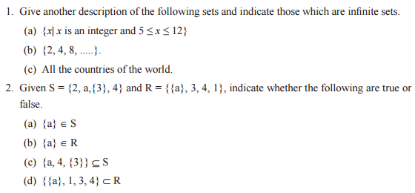
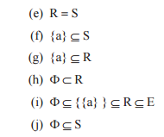
Problems for practice

Slide 26

Lecture -2, Operations on sets and its applications
OBJECTIVE
Introduction
Basic concepts of sets,
Types of Set
Operations on Sets
Operations on Sets Problems
Operations on Sets Applications

Slide 27
Operations on sets
i) Union of two sets: ‘∪’, ‘or’, ‘∨’
i.e., A ∪ B = { x / x ∈ A or x ∈ B, ∀x}
Ex: A ={1, 2, 3} and B = {3, 4, 5}
A ∪ B = {1, 2, 3}
A ∪ B = {1, 2, 3, 4, 5}
Also
B ∪ A = {3, 4, 5} ∪ {1, 2, 3}
B ∪ A = {1, 2, 3, 4, 5}
Note: A ∪ B = B ∪ A
A ∪ A = {1, 2, 3} ∪ {1, 2, 3}
A ∪ A = {1, 2, 3}
Note: A ∪ A = A
∪
{3, 4, 5}
= A

Slide 28
Operations on sets
ii) Intersection of two sets: ‘∩’, ‘and’, ‘∧’
i.e., A ∩ B = { x / x ∈ A and x ∈ B, ∀x}
Ex: A ={1, 2, 3} and B = {3, 4, 5}
A ∩ B = {1, 2, 3} ∩ {3, 4, 5}
A ∩ B = { 3 }
B ∩ A = {3, 4, 5} ∩ {1, 2, 3}
B ∩ A = { 3 }
Note: A ∩ B = B ∩ A
A ∩ A = {1, 2, 3} ∩ {1, 2, 3}
A ∩ A = {1, 2, 3}
Note: A ∩ A = A
= A

Slide 29
Operations on sets
iii) Difference of two sets: ‘ – ’
A – B = {x / x ∈ A and x ∉ B, ∀x}
Ex: A ={1, 2, 3} and B = {3, 4, 5}
A – B = {1, 2, 3} – {3, 4, 5}
A – B = {1, 2}
Also
B – A = {3, 4, 5} – {1, 2, 3}
B – A = {4, 5}
Note: A – B ≠ B – A
Ex: A ={3, 4, 5,7} and B = {1, 2, 3,… 6}
A – B = {3, 4, 5, 7} – {1, 2, 3, 4, 5, 6}
A – B = {7}
Also
B – A = {1, 2, 3, 4, 5, 6} – {3, 4, 5, 7}
B – A = {1, 2, 6}
Again A – B ≠ B – A
A – A ={3, 4, 5,7} - {3, 4, 5,7} = φ
------
/
------
/

Slide 30
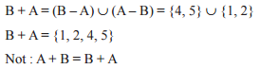
Operations on sets CONTD.
iv) Symmetric difference of two sets: ‘ + ’, ‘⊕’, ‘Δ’
A + B = A ⊕ B = A Δ B
A + B = {x / x ∈ (A – B) or x ∈ (B – A), ∀x }
Or A + B = (A – B) ∪ (B – A)
Ex: If A = {1, 2, 3} and B = {3, 4, 5} then find
A + B and B + A
Solution: w k t
A + B = (A – B) ∪ (B – A)
A – B = {1, 2, 3} – {3, 4, 5}
= {1, 2}
B – A = {3, 4, 5} – {1, 2, 3}
= { 4, 5}
A + B = (A – B) ∪ (B – A)
= {1, 2} ∪ {4, 5}
A + B = { 1, 2, 4, 5}

Slide 31
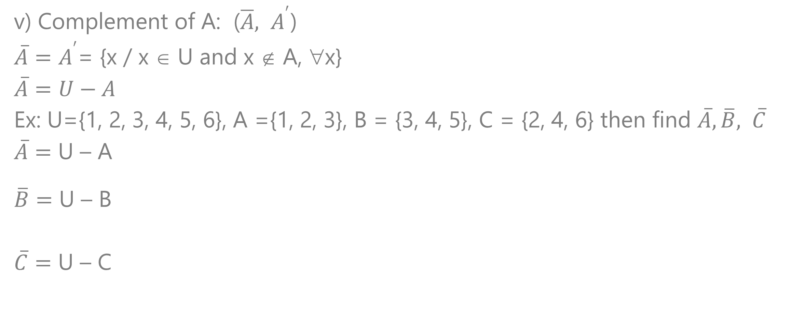
Operations on sets CONTD.
v) Complement of A: ($\overline{A}, A^{′}$)
$\overline{A}=A^{′}$= {x / x ∈ U and x ∉ A, ∀x}
$$\overline{A}=U−A$$
Ex: U={1, 2, 3, 4, 5, 6}, A ={1, 2, 3}, B = {3, 4, 5}, C = {2, 4, 6} then find $\overline{A},\overline{B}, \overline{C}$
$\overline{A}=$ U – A
$\overline{B}=$ U – B
$\overline{C}=$ U – C
={1, 2, 3, 4, 5, 6} –
{1, 2, 3}
={4, 5, 6}
={1, 2, 3, 4, 5, 6} –
{3, 4, 5}
={1, 2, 6}
={1, 2, 3, 4, 5, 6} –
{2, 4, 6}
={1, 3, 5}

Slide 32
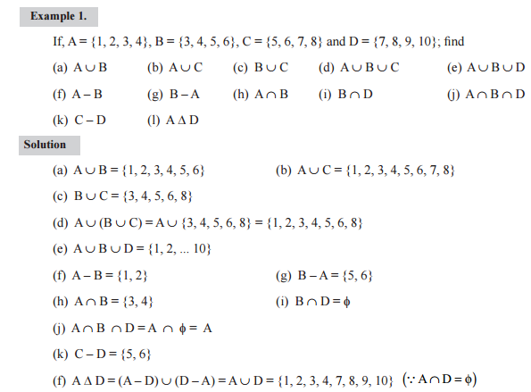
Operations on set problems

Slide 33
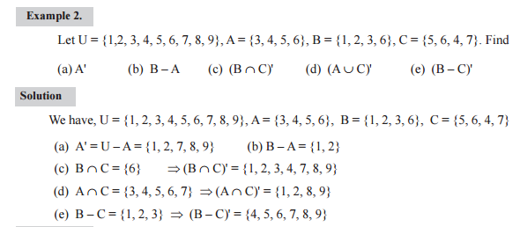
Operations on set Applications

Slide 34
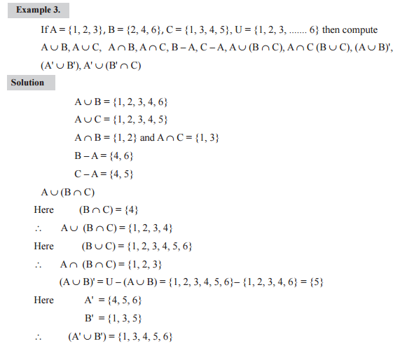
Operations on set Applications contd.

Slide 35
SUMMARY
Operations on Sets
Operations on Sets Problems
Operations on Sets Applications

Slide 36
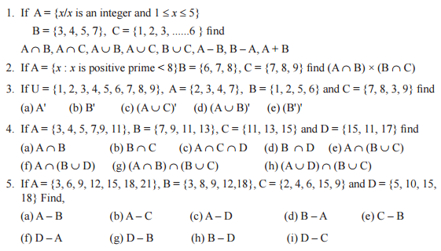
Problem for practice

Slide 37
Lecture -3, Venn diagrams, Some basic set identities, and its applications
OBJECTIVE
Operations on Sets
Operations on Sets Problems
Operations on Sets Applications
Venn Diagrams
Basic Set Identities
Set Identities Applications

Slide 38
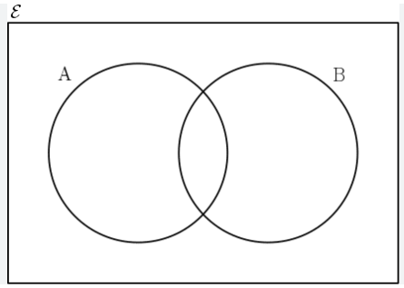
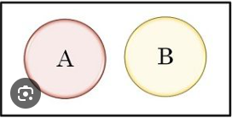

Venn Diagrams
Sets can be represented graphically using Venn diagrams, named after the English mathematician John Venn, who introduced their use in 1881. In Venn diagrams the universal set U, which contains all the objects under consideration, is represented by a rectangle. (Note that the universal set varies depending on which objects are of interest.)
Inside this rectangle, circles or other geometrical figures are used to represent sets. Sometimes points are used to represent the particular elements of the set.
Venn diagrams are often used to indicate the relationships between sets

Slide 39
Venn Diagrams contd.
A
B
A ∪ B
A ∩ B
A’
B’

Slide 40
Venn Diagrams contd.
A
B
A U B
A ∩ B
A’
B’

Slide 41
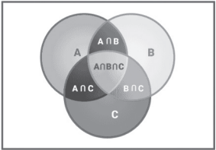
Venn Diagrams contd.
A – B
A ∩ B
B – A
A + B

Slide 42
Venn Diagrams contd.
A =
(A – B)
∪
(A ∩ B)
A – B
A ∩ B
B – A
B =
(B – A)
∪
(A ∩ B)
(A∪B) =
(A – B)
∪
(A ∩ B)
∪
(B – A)

Slide 43

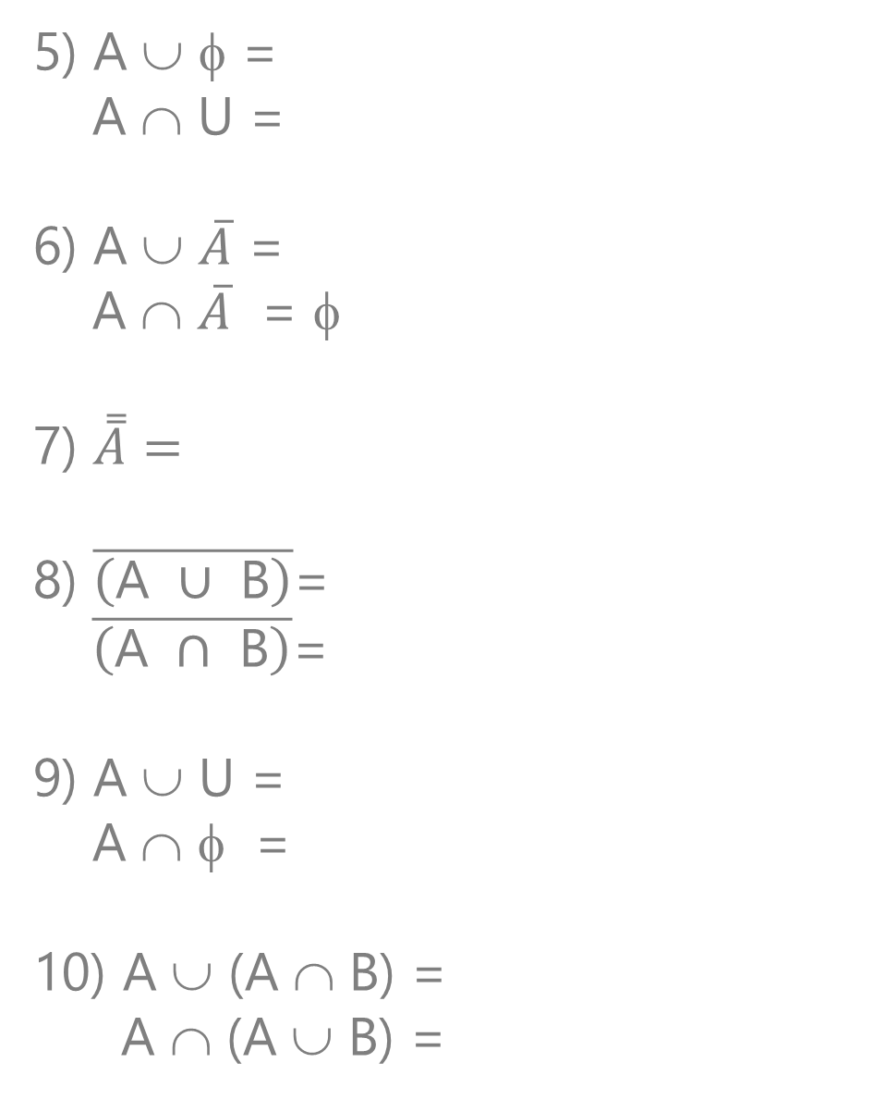
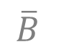


Basic Set Identities
5) A ∪ φ =
A ∩ U =
6) A ∪ $\overline{A}$ =
A ∩ $\overline{A}$ = φ
7) $\overset{̿}{A}=$
8) $\overline{\left(\text{A} ∪ \text{B}\right)}$=
$\overline{\left(\text{A} ∩ \text{B}\right)}$=
9) A ∪ U =
A ∩ φ =
10) A ∪ (A ∩ B) =
A ∩ (A ∪ B) =
A
A
Identity Laws
For any sets A, B, and C taken from a Universe set U
1) A ∪ B = B ∪ A
A ∩ B = B ∩ A
2) A ∪ (B ∪ C) =
A ∩ (B ∩ C) = (A ∩ B) ∩ C
3) A ∪ (B ∩ C) =
A ∩ (B ∪ C) =
4) A ∪ A = A
A ∩ A = A
U
Inverse Laws
Commutative Laws
A
Double Complement Law
(A ∪ B) ∪ C
Associative
$$\overline{A}$$
∩
$$\overline{B}$$
$$\overline{A}$$
∪
$$\overline{B}$$
Demorgon’s Laws
(A ∪ B)
∩
(A ∪ C)
Distributive
(A ∩ B) ∪ (A ∩ C)
U
Domination Laws
φ
Idempotent Laws
A
Absorption Laws
A

Slide 44
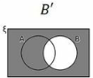
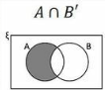
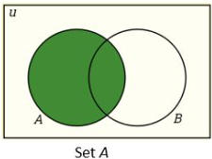
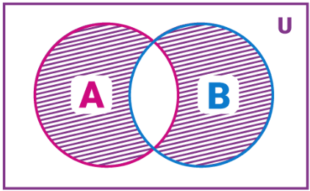





Set Identities Applications
$$11) A−B=$$
$$A∩\overline{B}$$
A – B
A – B B – A
$$12) A+B=$$
$$(A−B)$$
∪
$$( B−A)$$
= (A ∪ B) – (A ∩ B)

Slide 45
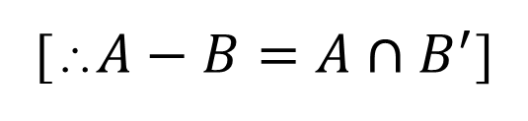
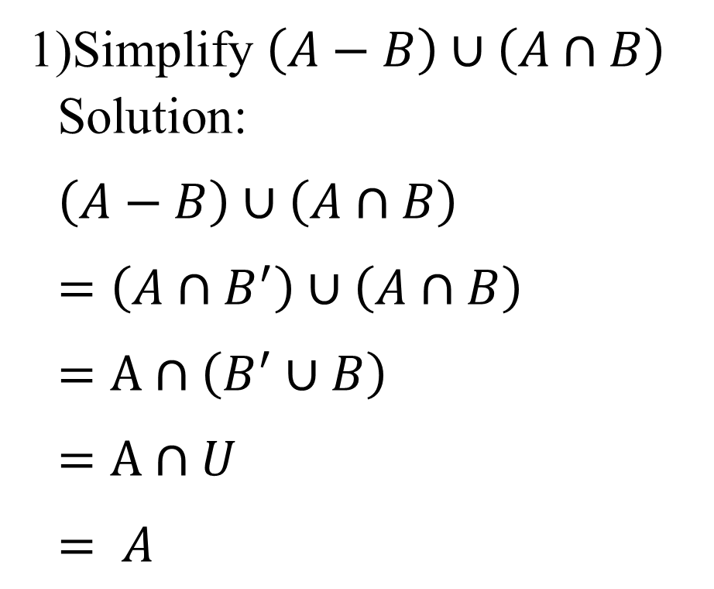
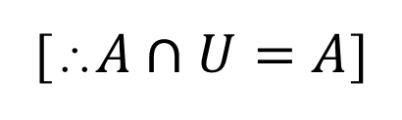
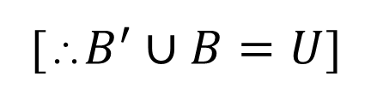
Set Identities Applications
Simplify $\left(A−B\right)∪\left(A∩B\right)$
Solution:
$\left(A−B\right)∪\left(A∩B\right)$
$=\left(A∩B^{′}\right)∪\left(A∩B\right)$
$=A∩\left(B^{′}∪B\right)$
$=A∩U$
$= A$
[∴$A−B=A∩B^{′}$]
[∴Distributive law]
[∴$B^{′}∪B=U$]
[∴$A∩U=A$]

Slide 46
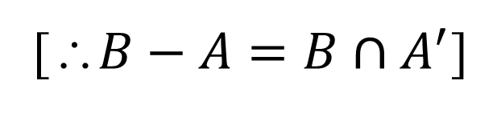
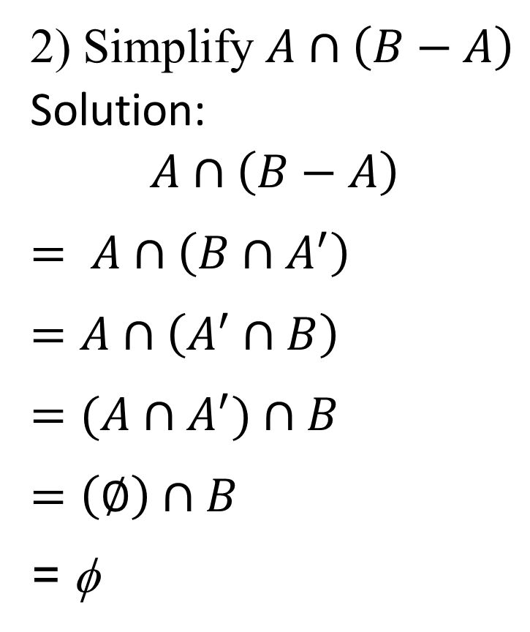
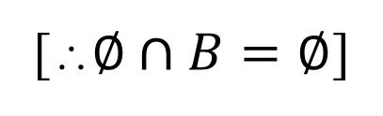
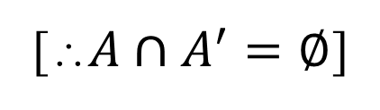
Set Identities Applications contd.
2) Simplify $A∩\left(B−A\right)$
Solution:
$$A∩\left(B−A\right)$$
$= A∩\left(B∩A^{′}\right)$
$=A∩\left(A^{′}∩B\right)$
$=(A∩A^{′})∩B$
$=\left(∅\right)∩B$
= φ
[∴$B−A=B∩A^{′}$]
[∴Commutative Law]
[∴Associative law]
[∴$A∩A^{′}=∅$]
[∴$∅∩B=∅$]

Slide 47
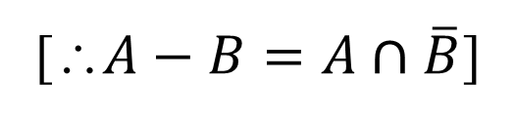
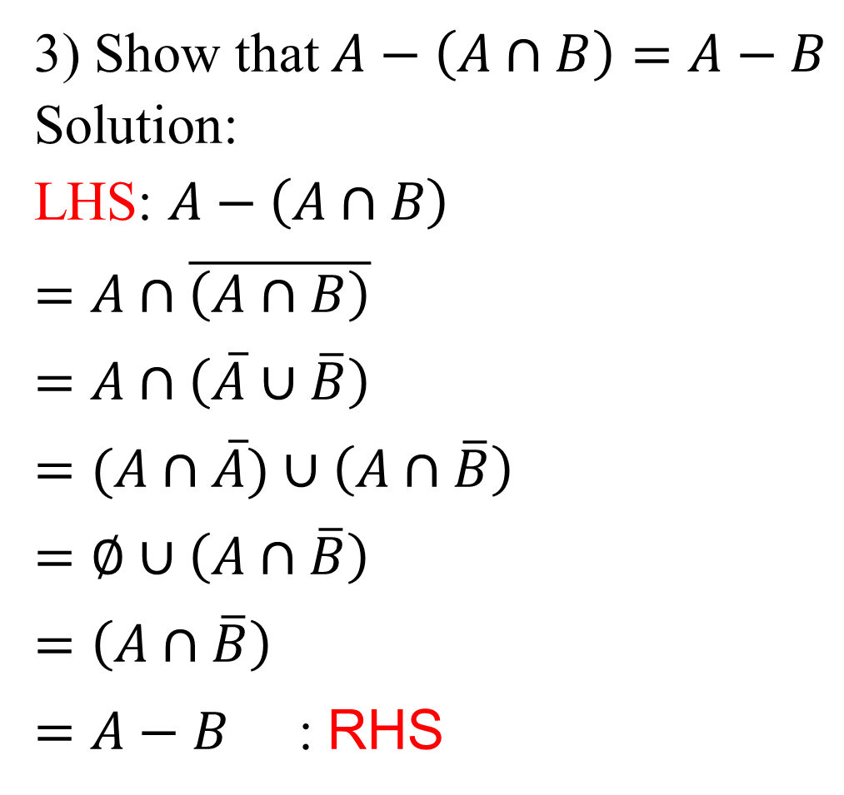
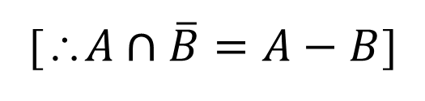
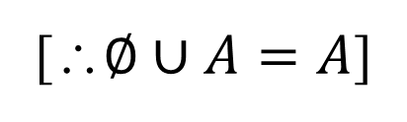
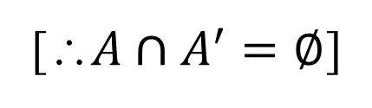
Set Identities Applications contd.
3) Show that $A−\left(A∩B\right)=A−B$
Solution:
LHS: $A−\left(A∩B\right)$
$=A∩\overline{\left(A∩B\right)}$
$=A∩\left(\overline{A}∪\overline{B}\right)$
$=(A∩\overline{A})∪\left(A∩\overline{B}\right)$
$=∅∪\left(A∩\overline{B}\right)$
$=\left(A∩\overline{B}\right)$
$=A−B$ : RHS
[∴$A−B=A∩\overline{B}$]
[∴DE Morgan's law]
[∴Distributive law]
[∴$A∩A^{′}=∅$]
[∴$∅∪A=A$]
[∴$A∩\overline{B}=A−B$]

Slide 48
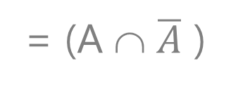
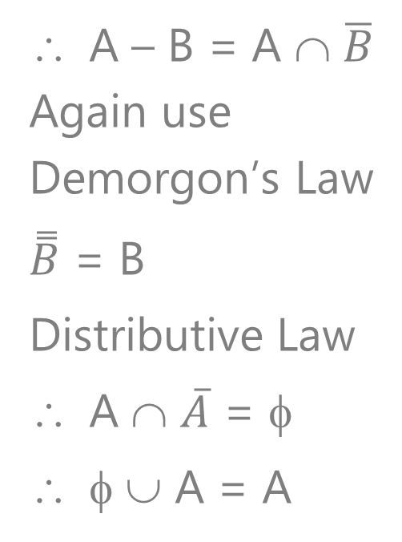
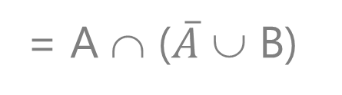
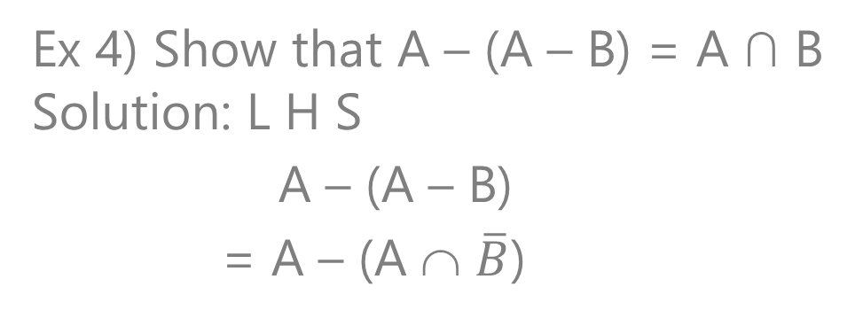
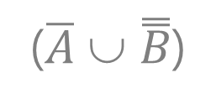
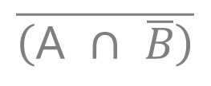
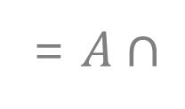
Set Identities Applications
Ex 4) Show that A – (A – B) = A ∩ B
Solution: L H S
A – (A – B)
= A – (A ∩ $\overline{B}$)
A – B = A ∩ $\overline{B}$
Again use
Demorgon’s Law
$\overset{̿}{B}$ = B
Distributive Law
A ∩ $\overline{A}$ = φ
φ ∪ A = A
= $A∩$
$$\overline{\left(\text{A} ∩ \overline{B}\right)}$$
= A ∩
($\overline{A}$ ∪ $\overset{̿}{B}$)
= A ∩ ($\overline{A}$ ∪ B)
= (A ∩ $\overline{A}$ )
∪
(A ∩ B)
= ( φ )
∪
(A ∩ B)
= (A ∩ B)
= R H S

Slide 49
SUMMARY
Venn Diagrams
Basic Set Identities
Set Identities Applications

Slide 50
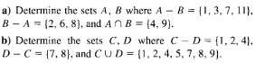
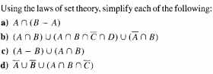
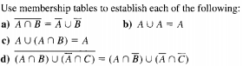
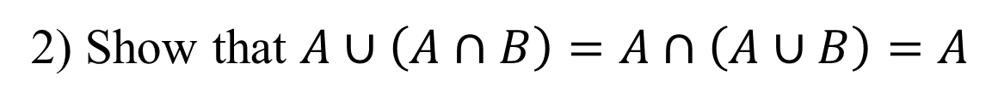
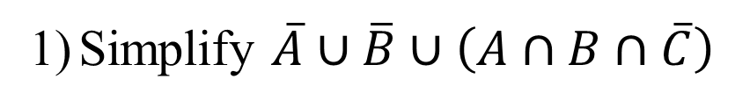
Problems for practice
Simplify $\overline{A}∪\overline{B}∪\left(A∩B∩\overline{C}\right)$
2) Show that $A∪\left(A∩B\right)=A∩\left(A∪B\right)=A$

Slide 51
Lecture -4, Cardinal number and its problems.
OBJECTIVE
Venn Diagrams
Basic Set Identities
Set Identities Applications
Cardinal Number
Cardinal Number Problems

Slide 52
Cardinal Number
Cardinal Number: A finite set “A” have countable number of elements that number is called cardinal number of set A and it’s denoted by n(A) (or |A|)
Example: (1) If A = {a, b, c, d, e} then |A| = n(A)
(2) If B = {1, 2, … 10} then |B| = n(B)
= 5
= 10

Slide 53
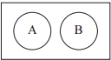
the principle of inclusion–exclusion.
1) If A and B are disjoint sets (A ∩ B = φ) then
n(A∪B) =
n(A) + n(B)

Slide 54
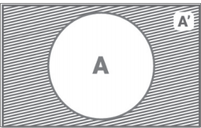
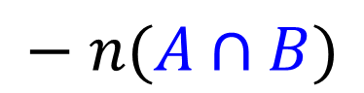
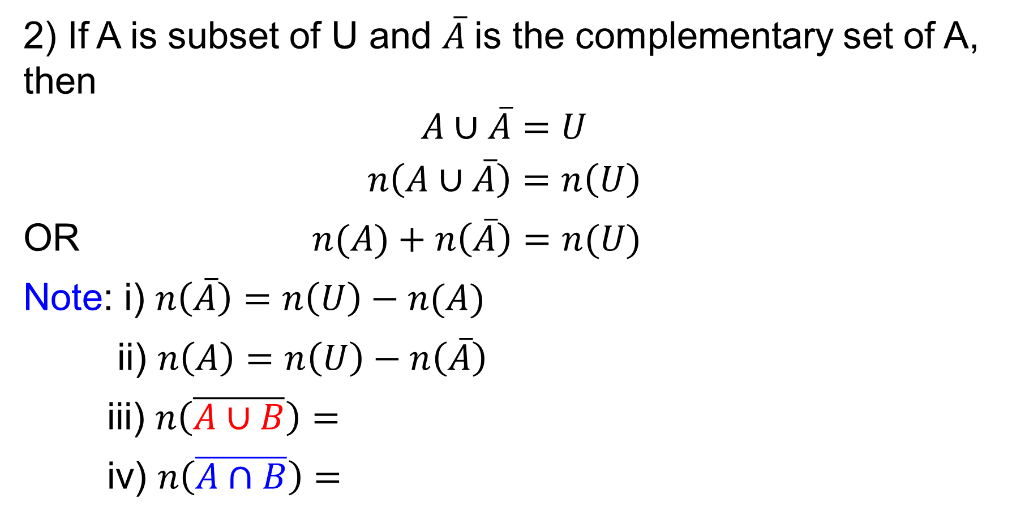
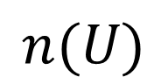
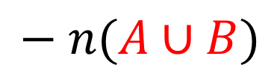
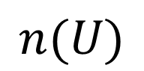
the principle of inclusion–exclusion CONTD.
2) If A is subset of U and $\overline{A}$is the complementary set of A, then
$$A∪\overline{A}=U$$
$$n\left(A∪\overline{A}\right)=n\left(U\right)$$
OR $n(A)+n\left(\overline{A}\right)=n(U)$
Note: i) $n\left(\overline{A}\right)=n\left(U\right)−n(A)$
ii) $n\left(A\right)=n\left(U\right)−n\left(\overline{A}\right)$
iii) $n\left(\overline{A∪B}\right)=$
iv) $n\left(\overline{A∩B}\right)=$
U
$$n(U)$$
$$− n(A∪B)$$
$$n(U)$$
$$− n(A∩B)$$

Slide 55

the principle of inclusion–exclusion CONTD.
3. If A and B are any two sets then
A = (A – B) ∪ (A ∩ B)
∴ n(A) = n (A – B) + n(A ∩ B)
Or n(A – B) =
A - B
A ∩B
B - A
n(A)
– n(A ∩ B)
similarly
B = (B – A) ∪ (A ∩ B)
∴ n(B) = n (B – A) + n(A ∩ B)
Or n (B – A) =
n(B)
– n(A ∩ B)
Only set A elements: n(A – B) = n(A) – n(A ∩ B)
Only set B elements: n(B – A) = n(B) – n(A ∩ B)

Slide 56
the principle of inclusion–exclusion CONTD.
4.If A and B are any two sets then
(A ∪ B) =
∴ n(A ∪ B) = n(A – B) + n(A ∩B) + n(B – A)
n(A ∪ B) =
n(A ∪ B) = n(A) + n(B) – n(A ∩ B)
Note: n(A ∩ B) = n(A) + n(B) – n(A ∪ B)
(A – B)
∪ (A ∩ B)
∪ (B – A)
A - B
A ∩B
B - A
n(A) – n(A ∩ B)
+ n(A ∩ B)
n(A – B) = n(A) – n(A ∩ B)
+ n(B) – n(A ∩ B)
n(B – A) = n(B) – n(A ∩ B)

Slide 57
the principle of inclusion–exclusion CONTD.
5.If A, B and C are any three sets then
n(A ∪ B ∪ C) =
n(A)
+ n(B)
+ n(C)
– n(A∩B)
– n(B∩C)
– n(C∩A)
+ n(A ∩ B ∩ C)
Only set A elements: n[A – (B∪C)] =
Only set B elements: n[B – (C∪A)] =
Only set C elements: n[C – (A∪B)] =
n(A)
– n(A ∩ B)
– n(A ∩ C)
+ n(A ∩ B ∩C)
n(B)
– n(B ∩ C)
– n(A ∩ B)
+ n(A ∩ B ∩C)
n(C)
– n(A ∩ C)
– n(B ∩ C)
+ n(A ∩ B ∩C)

Slide 58
the principle of inclusion–exclusion CONTD.
Only set ‘A & B’ elements: n[(A ∩ B) – C)] =
Only set ‘B & C’ elements: n[(B ∩ C) – A)] =
Only set ‘C & A’ elements: n[(C ∩ A) – B)] =
n(A ∩ B)
– n(A ∩ B ∩ C)
n(B ∩ C)
– n(A ∩ B ∩ C)
n(C ∩ A)
– n(A ∩ B ∩ C)

Slide 59
Cardinal Number Problems contd.
1) In a survey of 5000 persons, it was found that 2800 read Indian Express and 2300 read Times of India while 400 read both. (i) How many read only Indian Express, (ii) How many read only Times of India, (iii) How many of them read Indian Express and Times of India. (iv) How many read neither Indian Express nor Times of India.
Solution:
Let ‘A’ be the set of read Indian Express, n(A) = 2800
Let ‘B’ be the set of read Times of India, n(B) = 2300
Then both read (Indian Express and Times of India), i.e., n(A ∩ B) = 400
Total survey is done 5000, i.e., n(U) = 5000
(i) How many read only Indian Express
i.e., n(A – B) = n(A) –n(A∩B)
= 2800 – 400
= 2400

Slide 60
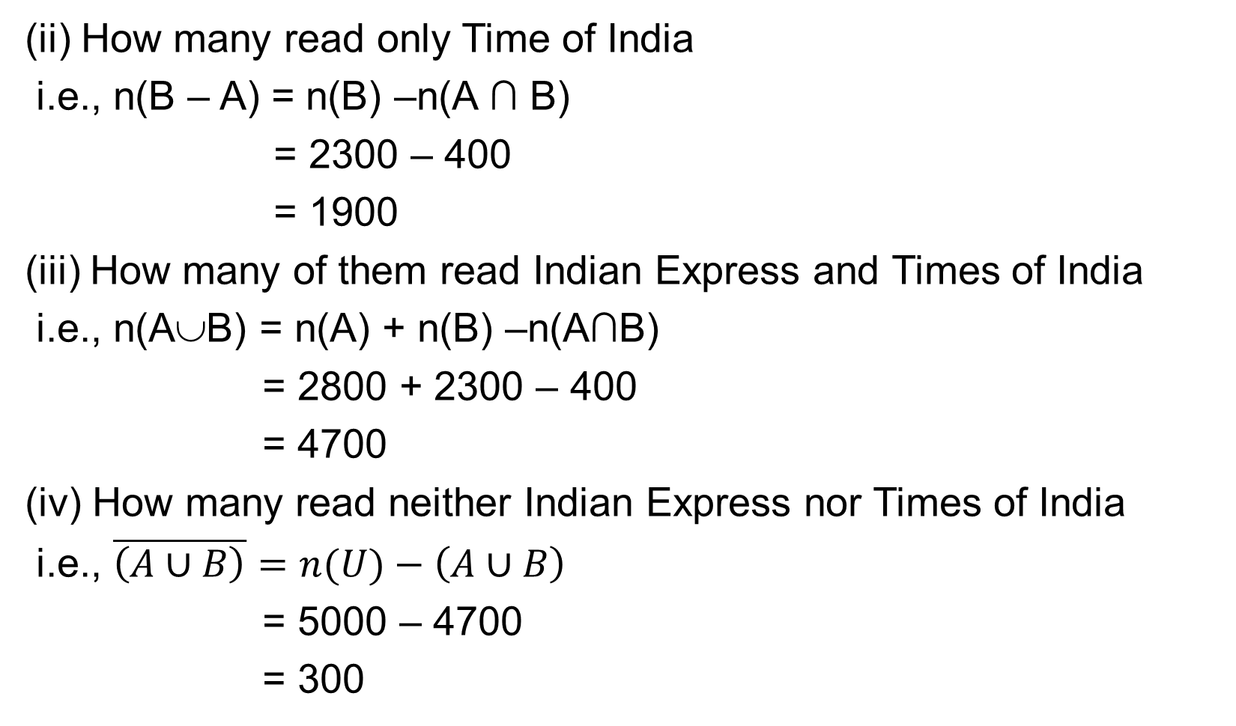
Cardinal Number Problems contd.
(ii) How many read only Time of India
i.e., n(B – A) = n(B) –n(A ∩ B)
= 2300 – 400
= 1900
(iii) How many of them read Indian Express and Times of India
i.e., n(A∪B) = n(A) + n(B) –n(A∩B)
= 2800 + 2300 – 400
= 4700
(iv) How many read neither Indian Express nor Times of India
i.e., $\overline{\left(A∪B\right)}=n(U)−\left(A∪B\right)$
= 5000 – 4700
= 300

Slide 61
Cardinal Number Problems contd.
2) A group of 80 people, 42 like’s coffee, 60 like’s tea and each person like atleast one of the two drinks. Find how many people like both coffee and tea.
Solution:
Let ‘A’ be set of like’s coffee, n(A) = 42
Let ‘B’ be set of like’s tea. n(B) = 60
Given each person like at least one of the two drinks means n(A ∪ B) = 80
Also total number of persons survey is 80, i.e., n(U) = 80
How many people like both coffee and tea, i.e., n(A ∩ B)
n(A∩B) = n(A) + n(B) –n (A∪B)
= 42 + 60 – 80
= 22

Slide 62
Cardinal Number Problems contd.
3) A survey of 500 television watches produced the following information: 285 watches football games, 195 watches hockey games, 115 watches basketball games, 45 watches football and basketball games, 70 watches football and hockey games, 50 watches hockey and basketball games and 50 do not watch any of the three kinds of games. Find how many people in the survey watch (i) all three kind of games, (ii) only football games, (iii) only hockey games, (iv) only basketball games, (v) only watch football and hockey, (vi) only watch hockey and basketball, (vii) only watch basketball and football games.
Solution:
A survey of 500 television watchers, n(U) = 500
Let ‘A’ be the set of football game watchers, n(A) = 285
Let ‘B’ be the set of hockey game watchers, n(B) = 195
Let ‘C’ be the set of basketball game watchers, n(C) = 115

Slide 63

Cardinal Number Problems contd.
45 watches football and basketball games ⇒ n(A ∩ C) = 45
70 watches football and hockey games ⇒ n(A ∩ B) = 70
50 watches hockey and basketball games ⇒ n(B ∩ C) = 50
50 do not watch any of the three kinds of games ⇒ $n\overline{\left(A∪B∪C\right)}$ = 50
(i) All three kind of games
$n\left(A∪B∪C\right)=n\left(U\right)−n\overline{\left(A∪B∪C\right)}$
= 500 − 50
= 450
To find many people watch atleast one of the games
n(A ∪ B ∪ C) = n(A) + n(B) + n(C) – n(A ∩ B) –n (B ∩ C) –n(C ∩ A) + n(A ∩ B ∩ C)
450 = 285 + 195 + 115 – 70 – 50 – 45 + n(A ∩ B ∩ C)
450 = 430 + n(A ∩ B ∩ C)
⇒ n(A ∩ B ∩ C) = 450 – 430 = 20

Slide 64
Cardinal Number Problems contd.
(ii) Only football games
n[A – (B ∪ C)] = n(A) – n(A ∩ B) – n (A ∩ C) + n(A ∩ B ∩ C)
= 285 – 70 – 45 + 20
= 190
(iii) Only hockey games
n[B – (C ∪ A)] = n(B) –n(B ∩ C)–n(B ∩ A) + n(A ∩ B ∩ C)
= 195 – 50 – 70 + 20
= 95
(iv) Only basketball games
n[C – (A ∪ B)] = n(C) – n(C ∩ A) –n(C ∩ B) + n(A ∩ B ∩ C)
= 115 – 45 – 50 + 20
= 40

Slide 65
Cardinal Number Problems contd.
(v) Only watch football and hockey
n[(A∩B) –C] = n(A∩B) –n(A∩B∩C)
= 70 – 20
= 50
(vi) Only watch hockey and basketball
n[(B∩C) –A] = n(B∩C) –n (A∩B∩C)
= 50 – 20
= 30
(vii) Only watch basketball and football games
n[(C∩A) – B] = n(C∩A) –n(A∩B∩C)
= 45 – 20
= 25

Slide 66



Cardinal Number Problems contd.
Ex 4. Find how many integers between 1 and 2335 are divisible by either 2 or 3
Solution:
Let ‘A’ be number of integers between 1 and 2335 are divisible by 2,
Let ‘B’ be number of integers between 1 and 2335 are divisible by 3,
Let ‘A & B’ be number of integers between 1 to 2335 are divisible by 2 & 3,
(i) How many integer between 1 and 2335 are divisible by either 2 or 3 is
n(A ∪ B) = n(A) + n(B) – n(A ∩ B)
= 1167 + 778 – 389 = 1556

Slide 67
SUMMARY
Cardinal Number
Cardinal Number Problems

Slide 68

Problems for practice
In a survey of 260 college students, the following data were obtained: 64 had taken a mathematics course, 94 had taken a computer science course, 58 had taken a business course, 28 had taken both mathematics and business course, 26 had taken both mathematics and computer science course, 22 had taken both computer science and business course and 14 had taken all three types of courses.
i) How many of these students had taken none of the three courses?
ii) How many had taken only a computer science courses?
2. A professor has two dozen introductory text books on computer science and is concerned about their coverage of the topics ($A$) Compilers, ($B$) Data Structures and ($C$) Operating systems. The following data are the number of books that contain material on these topic: $\left|A\right|=8, \left|B\right|=13, \left|C\right|=13, \left|A∩B\right|=5,$ $\left|A∩C\right|=3, \left|B∩C\right|=6, \left|A∩B∩C\right|=2$
i) How many of the text books include material on exactly one of these topics?
ii) How many do not deal with any of these topics?
iii) How many have no materials on compliers?

Slide 69
Lecture -5, Cartesian products, Relations, Properties of relations
OBJECTIVE
Cardinal Number
Cardinal Number Problems
Cartesian Products
Relations
Properties of Relations
Types of Relations

Slide 70
Cartesian Products
Relationships between elements of sets are represented using the structure called a Relation.
which is just a subset of the Cartesian product of the sets.
Relations can be used to solve problems such as determining which pairs of cities are linked by train route, airline flights in a network etc.,
Ordered Pairs
By an ordered pair of elements, we mean a pair (a, b) of elements a and b,
here refer a is called first element" and b is called "second element".
Example: (a, b) , (1, 2), (2, 1), etc.,

Slide 71
Cartesian Products contd.
Definition (Cartesian product of two sets). The Cartesian product of two sets A and B, denoted by A × B is the set of all ordered pairs (a, b), such that a ∈A and b ∈ B.
i.e., A × B = {(a, b) | a ∈A, b ∈ B ∀ a, b}
Note: If A has m elements and B has n elements then A × B will have m.n elements.
Eg: A = {1, 2, 3}, B = {a, b, c}
A × B = {(1, a),
Again B = {a, b, c}, A = {1, 2, 3}
B × A = {(a, 1), (a, 2), (a, 3), (b, 1), (b, 2), (b, 3), (c, 1), (c, 2), (c, 3)}
(1, b),
(1, c),
(2, a),
(2, b),
(2, c),
(3, a),
(3, b), (3, c)}
n(A x B) = n(A) . n(B) =
3.3 = 9
A x B ≠ B x A

Slide 72


Cartesian Products contd.

Slide 73

Cartesian Products contd.

Slide 74
Relations
Let A and B be two sets. A binary relation R from A to B is a subset of A × B. It is denoted by aRb, or ªR_{b}.
R ⊆ A X B
(OR) Any set of ordered pairs defined a binary relation
Eg: A = {1, 2, 3}, B = {a, b}
A × B = {(1, a),
(1, b),
(2, a),
(2, b),
(3, a),
(3, b) }
Relation is
R₁ = {(1, a),
(2, a),
(3, a) }
R₁ ⊆ A X B
R₂ ⊆ A X B
R₃ ⊆ A X B
R₄ ⊄ A X B
∴ R₁ is relation
∴ R₂ is relation
∴ R₃ is relation
∴ R₄ is not relation
R₂ = {(1, b),
(2, b),
(3, b) }
R₃ = {(1, a),
(1, b) }
R₄ = {(1, a),
(1, b),
(a, 1) }

Slide 75
Relations CONTD.
Ex. If A = {1, 2, 3, 4} find the relation for the following
R₁ = { (a, b) / a ≥ b, ∀ a, b ∈ A}
Solution:
2) R₂ = { (a, b) / a > b, ∀ a, b ∈ A}
Solution:
R₁ = {(4, 1),
(4, 2),
(4, 3),
(4, 4),
(3, 1),
(3, 2),
(3, 3),
(2, 1),
(2, 2),
(1, 1) }
R₂ = {(4, 1),
(4, 2),
(4, 3),
(3, 1),
(3, 2),
(2, 1) }

Slide 76
Relations CONTD.
Ex. If A = {1, 2, 3, 4} find the relation for the following
3) R₃ = { (a, b) / a ≤ b, ∀ a, b ∈ A}
Solution:
4) R₄ = { (a, b) / a < b, ∀ a, b ∈ A}
Solution:
R₃ = {(1, 1),
(1, 2),
(1, 3),
(1, 4),
(2, 2),
(2, 3),
(2, 4),
(3, 3),
(3, 4),
(4, 4) }
R₄ = {(1, 2),
(1, 3),
(1, 4),
(2, 3),
(2, 4),
(3, 4) }

Slide 77

Properties of relations
A relation R on a set A is called reflexive if (a, a) ∈ R for every element a ∈ A.
Ex. A = {1, 2, 3} and R_{i} ⊆ A x A
Verify the following are relation, then find its reflexive or not
R₁ = {(1, 1), (2, 2), (3, 3), (1, 2)}
Here (1, 1) ∈ R₁
(2, 2) ∈ R₁
(3, 3) ∈ R₁,
Clearly ∀ a ∈ A
∴R₁ is reflexive
2) R₂ = {(1,1), (2, 2), (3, 1)}
Here (1, 1) ∈ R₂
(2, 2) ∈ R₂
But (3, 3) ∉ R₂
Clearly ∀ a ∉ A
∴R₂ is not reflexive

Slide 78
Properties of relations contd.
A relation R on a set A (i.e., R ∈ A x A) is called symmetric
if (b, a) ∈ R whenever (a, b) ∈ R, for all a, b ∈ A.
i.e., (a, b) ∈ R
R₁ = {(1, 1), (1, 2), (2, 1)}
Here (1, 1) ∈ R₁
(1, 2) ∈ R₁
(2, 1) ∈ R₁
Clearly ∀ a, b ∈ A
∴R₁ is symmetric
⇒ (b, a) ∈ R, for all a, b ∈ A
⇒ (1, 1) ∈ R₁
⇒ (2, 1) ∈ R₁
⇒ (1, 2) ∈ R₁

Slide 79
Properties of relations contd.
A relation R on a set A (R ∈ A x A) is called symmetric
if (b, a) ∈ R whenever (a, b) ∈ R, for all a, b ∈ A.
i.e., (a, b) ∈ R
2) R₂ = {(1, 1), (2, 2), (1, 3), (3, 2), (2, 3) }
Here (1, 1) ∈ R₂
(2, 2) ∈ R₂
(1, 3) ∈ R₂
one element does not satisfy then no need check reminder element
Clearly ∀ a, b ∉ A
∴R₂ is not a symmetric
⇒ (b, a) ∈ R, for all a, b ∈ A
⇒ (1, 1) ∈ R₂
⇒ (2, 2) ∈ R₂
⇒ (3, 1) ∉ R₂

Slide 80
Properties of relations contd.
A relation R on a set A (R ∈ A x A) is called transitive
if whenever (a, b) ∈ R and (b, c) ∈ R, then (a, c) ∈ R, for all a, b, c ∈ A.
i.e., (a, b) ∈ R
Ex 1) R₁ = {(1, 2), (2, 1), (1, 1), (2, 2) }
Here (1, 2) ∈ R₁
(2, 1) ∈ R₁
(1, 1) ∈ R₁
(2, 2) ∈ R₁
Clearly ∀ a, b, c ∈ A
∴R₁ is transitive
/
& (b, c) ∈ R
⇒ (a, c) ∈ R, for all a, b, c ∈ A
/
& (2, 1) ∈ R₁
⇒ (1, 1) ∈ R₁
& (1, 2) ∈ R₁
⇒ (2, 2) ∈ R₁
& (1, 2) ∈ R₁
⇒ (1, 2) ∈ R₁
& (2, 1) ∈ R₁
⇒ (2, 1) ∈ R₁

Slide 81
Properties of relations contd.
A relation R on a set A (R ∈ A x A) is called transitive
if whenever (a, b) ∈ R and (b, c) ∈ R, then (a, c) ∈ R, for all a, b, c ∈ A.
i.e., (a, b) ∈ R
Ex 1) R₂ = {(1, 3), (1, 1), (2, 3), (3, 1) }
Here (1, 3) ∈ R₂
(1, 1) ∈ R₂
(2, 3) ∈ R₂
one element does not satisfy then no need check reminder element Clearly ∀ a, b, c ∉ A
∴R₂ is not transitive
/
& (b, c) ∈ R
⇒ (a, c) ∈ R, for all a, b, c ∈ A
/
& (3, 1) ∈ R₂
⇒ (1, 1) ∈ R₂
& (1, 3) ∈ R₂
⇒ (1, 3) ∈ R₂
& (3, 1) ∈ R₂
⇒ (2, 1) ∉ R₂

Slide 82
Properties of relations contd.
A relation R on a set A (R ∈ A x A) is called an Irreflexive
if (a, a) ∉ R, for every a ∈ A,
Ex 1) A = {1, 2, 3} and R_{i} ⊆ A x A, then
R₁ = {(1, 2), (2, 3), (3, 1), (1, 3) }
Here clearly (a, a)∉ R, for every a ∈ A
∴ R₁ is an Irreflexive
Ex 2) R₂ = {(1, 3), (2, 3), (1, 1), (3, 2) }
Here clearly (1, 1)∈ R₂,
But definition against (a, a) ∉ R, for every a ∈ A,
∴ R₂ is not an Irreflexive

Slide 83
Properties of relations contd.
A relation R on a set A such that
if (a, b) ∈ R and (b, a) ∈ R, then a = b for all a, b ∈ A,
is called antisymmetric.
i.e., (a, b) ∈ R
Ex 1) If A ={1, 2, 3}, R₁ = {(1, 1), (2, 2) }
Here (1, 1) ∈ R₁
(2, 2) ∈ R₁
Clearly ∀ a, b ∈ A
∴R₁ is antisymmetric
& (b, a) ∈ R
⇒ a = b, ∀ a, b
& (1, 1) ∈ R₁
⇒ 1 =1, 1 ∈ R₁
& (2, 2) ∈ R₁
⇒ 2 = 2, 2 ∈ R₁

Slide 84
Properties of relations contd.
A relation R on a set A such that
if (a, b) ∈ R and (b, a) ∈ R, then a = b for all a, b ∈ A,
is called antisymmetric.
i.e., (a, b) ∈ R
Ex 2) If A ={1, 2, 3}, R₂ = {(1, 1), (2, 3), (3, 2) }
Here (1, 1) ∈ R₂
(2, 3) ∈ R₂
Clearly ∀ a, b ∉ A
∴R₂ is not antisymmetric
& (b, a) ∈ R
⇒ a = b, ∀ a, b
& (1, 1) ∈ R₂
⇒ 1 =1, 1 ∈ R₂
& (3, 2) ∈ R₂
But 2 ≠ 3,

Slide 85
types of relations
The relation R = A × A on A is called an universal relation in A
Eg: A = {1, 2, 3}
Here R = {(1, 1), (1, 2), (1, 3), (2, 1), (2, 2), (2, 3), (3, 1), (3, 2), (3, 3)}
But A x A is
A × A = {(1, 1), (1, 2), (1, 3), (2, 1), (2, 2), (2, 3), (3, 1), (3, 2), (3, 3)}
Clearly R = A x A
∴R is an universal relation

Slide 86
types of relations contd.
Let R be a relation from the set A into B. The inverse relation denoted by R^{–1} from B to A and it's defined by
R = {(a, b) / a ∈ A & b ∈ B ∀ a, b}
Then R^{–1} = {(b, a) / (a, b) ∈ R ∀ a, b}
Eg: R = {(1, a), (2, a), (2, b), (3, a), (3, c)}
R^{–1} =
{(a, 1),
(a, 2),
(b, 2),
(a, 3),
(c, 3)}

Slide 87

types of relations contd.
If A = {1, 2, 3} and its relation R ⊆ A × A, Then Complement of R is defined as $\overline{R}$
i.e., $\overline{R}=\left(A x A\right)−R=U−R$
Ex 1) If R = {(1, 1), ( 1, 2), (2, 1), (2, 3), (3, 1)}
Then $\overline{R}=(A x A)−R$
Here A x A =
$ \overline{R}$ =
{(1, 1),
(1, 2),
(1, 3),
(2, 1),
(2, 2),
(2, 3),
(3, 1), (3, 2), (3, 3)}
{ (1, 3),
(2, 2),
(3, 2), (3, 3)}

Slide 88
SUMMARY
Cartesian Products
Relations
Properties of Relations
Types of Relations

Slide 89


Problem for practice

Slide 90
Lecture -6, Equivalence relation and composite of relations problems
OBJECTIVE
Cartesian Products
Relations
Properties of Relations
Types of Relations
Equivalence Relation
Composite of Relation

Slide 91


Equivalence Relation

Slide 92

Equivalence Relation contd.

Slide 93
Equivalence Relation contd.
Example 2) Let A = {1, 2, 3, 4, 5, 6, 7} and R = {(x, y) | x – y is divisible by 3} show that R is an equivalence relation.
Example 3) Let R be the relation on the set of real numbers such that aRb if and only if a − b is an integer. Is R an equivalence relation?

Slide 94
Composite of Relation
Definition: Let ‘R’ be a relation from ‘a’ to ‘b’ and ‘S’ be a relation from ‘b’ to ‘c’. Then the relation written as RoS is called a composite relation of ‘R’ and ‘S’, where
R o S = {(a, c) / (a, b) ∈ R and (b, c) ∈ S, for all a, b, c}
Here R² = R o R, R³ = R² o R = (R o R) o R = R o (R o R)

Slide 95
Composite of Relation contd.
Ex 1) Let R = {(1, 2), (3, 4), (2, 2)} and S = {(4, 2), (2, 5), (3, 1), (1, 3)}, then find RoS, SoR, R², S², Ro(SoR), (RoS)oR, R³.
Solution:
RoS
S = {(4, 2), (2, 5), (3, 1), (1, 3)}
R o S ⇒ RoS
(1, 2)
(3, 4)
(2, 2)
⇒
⇒
⇒
(1, 5)
(3, 2)
(2, 5)
/
(2, 5)
(4, 2)
(2, 5)
/
RoS = { (1, 5), (3, 2), (2, 5) }

Slide 96

Composite of Relation contd.

Slide 97

Composite of Relation contd.

Slide 98

Composite of Relation contd.

Slide 99
SUMMARY
Equivalence Relation
Composite of Relation

Slide 100


Problems for practice

Slide 101

Lecture -7, Relation matrix and its application problems
OBJECTIVE
Equivalence Relation
Composite of Relation
Relation Matrix
Relation Matrix Problems

Slide 102



Relation Matrix

Slide 103

Relation Matrix problems

Slide 104


Relation Matrix problems contd.

Slide 105


Relation Matrix problems contd.

Slide 106
SUMMARY
Relation Matrix
Relation Matrix Problems

Slide 107

Problems for practice

